Slide 1


Slide 2
What is bluetooth?
Bluetooth wireless technology is an open specification for a low-cost, low-power, short-range radio technology for ad-hoc wireless communication of voice and data anywhere in the world.
It is a cable replacement technology.
Wireless communication between various devices within a small area.
Used to swap data and synchronize between various devices

Slide 3
Introduction
1994 Ericsson gets interested in wireless connections from mobile telephones to other devices like PDAs and accessories like Headsets
Forming the SIG (SpecialInterestGroup) with 4 other members (IBM, Intel, Nokia, Toshiba) in order to develop a wireless standard for communication between mobile devices

Slide 4
Introdution
Today over 2000 members
2 main priorities:
Cheap
Lower energy consumption
IEEE 802.15 committee standardizes the physical and link layer
SIG still enhances Bluetooth
two versions in future possible
(SIG vs IEEE)

Slide 5
Overview
Originally conceived as a cable replacement technology
Other usage models began to develop:
Personal Area Network (PAN)
Ad-hoc networks
Data/voice access points
Wireless telematics

Slide 6
Overview
Advantages
Bluetooth: interoperable
Infrared Data Association IrDA: line of sight needed, point-to-point
WLAN: higher power consumption
Disadvantages
Bluetooth: only up to 1 Mbps
IrDA: much cheaper, faster (up to 16 Mbps)
WLAN: faster (up to 11 Mbps)
WLAN and Bluetooth interfere each other (both are using the ISM band)

Slide 7
Frequency Band
Diff Frequency ranges for diff countries.
Europe & USA-2400-2483.5 MHz.
Japan-2471-2497 MHz.
Spain-2445-2475 MHz.
France-2445-2483.5 MHz.
SIG Working towards harmonization of frequency.

Slide 8
How it works
Bluetooth is based on low cost, short-ranged radio link, operates in Radio band of 2.4GHz , and provides a range of 10 meters.
Connections can be point-to-point or multipoint.
Devices connected to each other, they form a personal area network (PAN) called the Pico net.
Each Pico net can have a master, and up to 7 active and 255 parked slaves.
Different Pico nets are connected using a common device and such networks are called scatter net

Slide 10
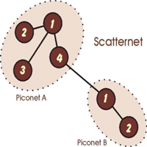

Slide 11
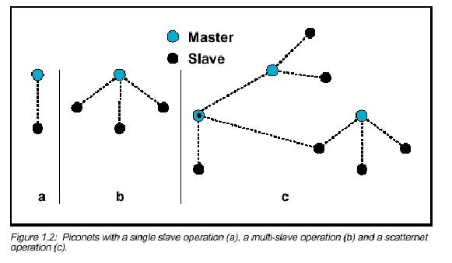

Slide 12
Ad-hoc-networking
piconet
decentral, one master up to 7 slaves
up to 255 parked slaves
point to point or point to multipoint conn
unique bluetooth device address
scatternet
overlapping of two piconets, up to 10
different hopping sequences
peer to peer (P2P) network

Slide 13
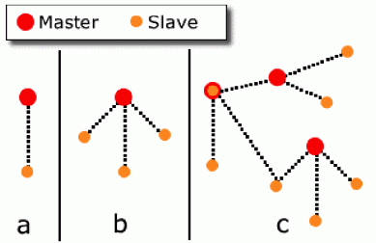
Ad-hoc-networking
a: piconet with a single slave
b: piconet with a multi slave
c: scatternet

Slide 14
Bluetooth Protocol Stack
Applications
Application
RFCOMM/SDP
Presentation Layer
L2CAP
Session Layer
Host Controller Interface
Transport Layer
Link Manager
Network Layer
Link Controller
Data Link Layer
Baseband
PHY
RF
OSI/ISO

Slide 15
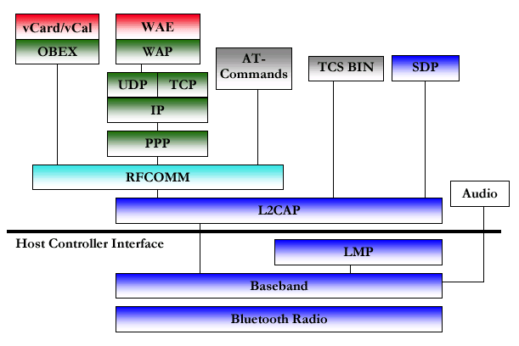
Specifications & Layers
specification protocol stack

Slide 16
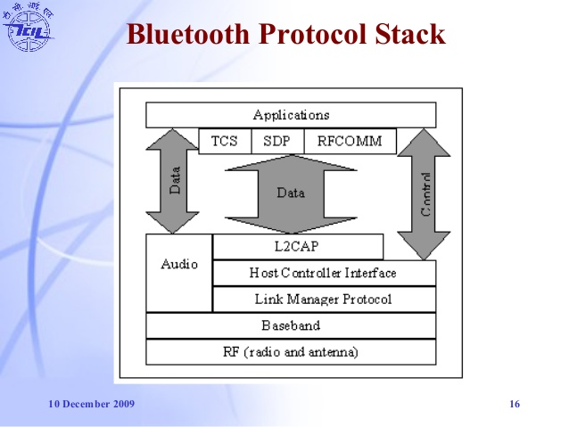
Specifications & Layers

Slide 17
Layers
Bluetooth Radio
Baseband
LMP (Link Manager Protocol)
HCI (Host Controller Interface)
L2CAP (Logical Link Control and Adaptation Protocol)
RFCOMM (Radio Frequency Communication)
SDP (Service Discovery Protocol)

Slide 18
Bluetooth Radio
the lowest defined layer of the Bluetooth specification
operating in the 2,4 GHz ISM Band
accomplishes spectrum spreading by frequency hopping (FHSS) from 2.402 GHz to 2.480 GHz

Slide 19
Bluetooth Radio
3 different power classes
Power Class1: long range (100m,100mW)
Power Class2: mid range (10m,1-2,5mW)
Power Class3: short range (0.1-10m,1mW)
signal strength adjustment

Slide 20
Baseband
the physical layer of the Bluetooth that provides
Error correction
Flow control
Hopping sequence
Security
hopping through 79 channels
data is divided in packets
access code: e.g. timing synchronization
header: e.g. packet numbering, flow control, slave address
payload: voice, data or both

Slide 21
Baseband
Connection Modes
It describes the set of rules by which all bluetooth devices must abide in order to establish a link a communicate with one another
STANDBY : not connected in a piconet
ACTIVE : active participation on the channel
Power Saving Modes
SNIFF : slave listens to the channel at a reduced rate (decreasing of duty cycle ) least power efficient
HOLD : data transfer is held for a specific time period, medium power efficient
PARK : synchronized to the piconet but does not participate in traffic

Slide 22
Baseband
Security Modes
non-secure
encryption enforced by application layer
encryption enforced by link layer
For devices
trusted device
untrusted device
For services
require authorization and authentication
require authentication
open to all devices

Slide 23
Audio
two codecs: PCM and CVSD
both at 64kbit/s
synchronous connection oriented(SCO) links
time-critical
no retransmission
errors appear as background noise

Slide 24
LMP (Link Manager Protocol)
provides authentication, link setup and link configuration including power surveillance
takes place as a service provider
communication with LM PDUs (protocol data units)

Slide 25
HCI (Host Controller Interface)
provides a command interface to baseband controller and link manager
also to hardware status, control and event register
Bluetooth defined Host Controller Transport Layers:
UART (HCI over serial interface)
RS232(HCI over serial interface)
USB(HCI over USB interface e.g. USB dongle)

Slide 26
L2CAP (Logical Link Control and Adaptation Protocol)
provides a connection-oriented and connectionless service to upper layer
protocols with quality-of-service functions using multiplexing, segmentation and reassembly
two link types defined in Baseband layer:
1. SCO (synchronous connection-oriented)
2. ACL (asynchronous connection-less)
BUT ONLY ACL is supported by L2CAP
(SCO not planned)

Slide 27
RFCOMM (Radio Frequency Communication)
Provides emulation of serial ports
Supports up to 60 simultaneous connections
Differentiates between two device types:
Type 1: communication end points (e.g. printer or headsets)
Type 2: devices which are part of communication (e.g. modems)
But in the protocol itself no distinction is made, some information is for type 1 other for type 2

Slide 28
SDP (Service Discovery Protocol)
discovers which services are available
identifies the characteristics of the services
uses a request/response model where each transaction consists of one request protocol data unit (PDU) and one response PDU
SDP is used with L2CAP
is optimized for the dynamic nature of bluetooth
SDP does not define methods for accessing services

Slide 29
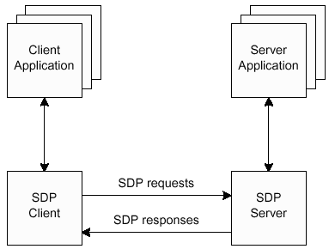
SDP (Service Discovery Protocol)

Slide 30
Wireless Application Protocol (WAP)
Wide Area Ethernet (WAE)
TCS-BIN Telephony Control Specification—Binary
AT commands --modem commands are called AT commands.
Many of the commands that are used to control wired dial-up modems, such as ATD (Dial), ATA (Answer), ATH (Hook control) and ATO (Return to online data state)

